Slide 1

Ethereum Trading Trend Prediction and Time Series Analysis
INFO 501: Introduction to Python and Data Mining
Dev Shah | Jake Castellano | Nayanpreet Chhabra | Shunottara Ingle

Slide 2
TABLE OF CONTENTS
3
Introduction
4
Data Collection/Preprocessing
11
Techniques and Modeling
21
Results and Insights
17
Summary

Slide 3

INTRODUCTION
Cryptocurrency is relatively new and exciting for investors
It can be unpredictable and risky
Predictive time series analysis can provide confidence
Identify trends, support decisions, and handle uncertainty

Slide 4

Data Collection
Dataset Details
Our data was collected from Kaggle.
The dataset spanned from 2018 to 2024
Key information in the dataset:
Open
High
Low
Close
Volume

Slide 5

Data Preprocessing
Preprocessing cont’d
Loaded csv file into pandas DataFrame
Handled missing values
Parse time column to datetime
Create new features:
Lag on Close
Rolling means
Normalized data
Outlier detection
Training and testing splits

Slide 6
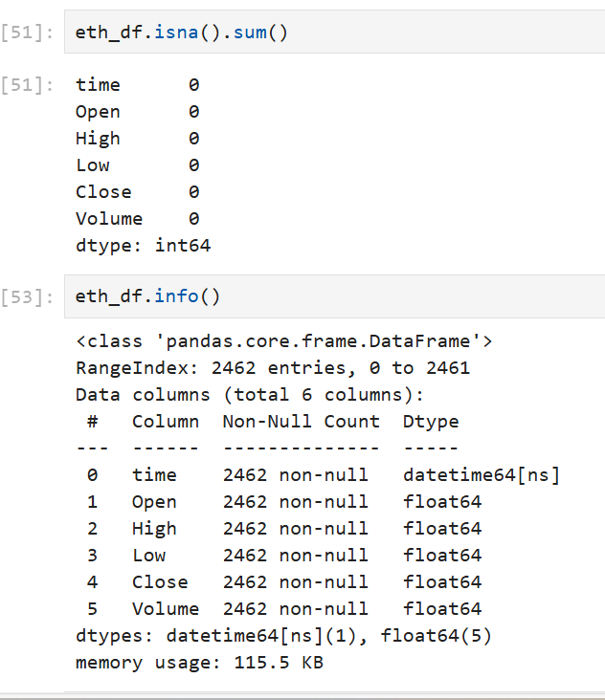
Null values and Info
Preprocessing
Null values -
There were no null values, therefore we did not have to deal with it.
Info of all the columns

Slide 7
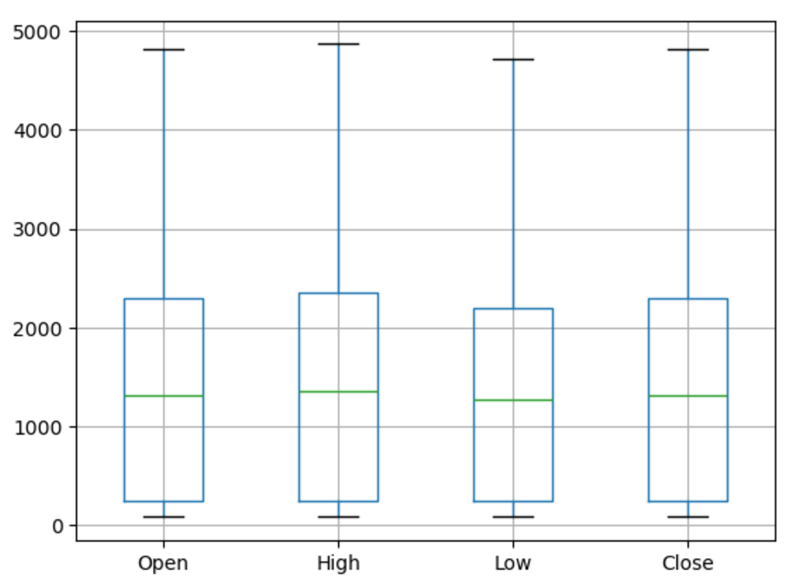
Boxplot - Open, High, Low, Close
Topic
Preprocessing

Slide 8
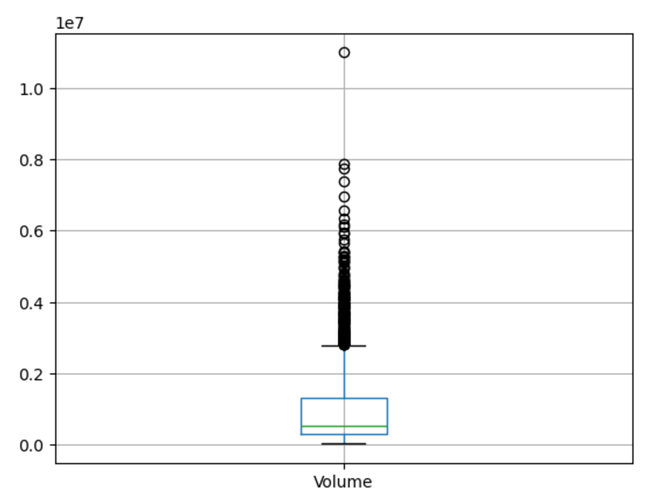
Boxplot - Volume
Topic
Preprocessing

Slide 9
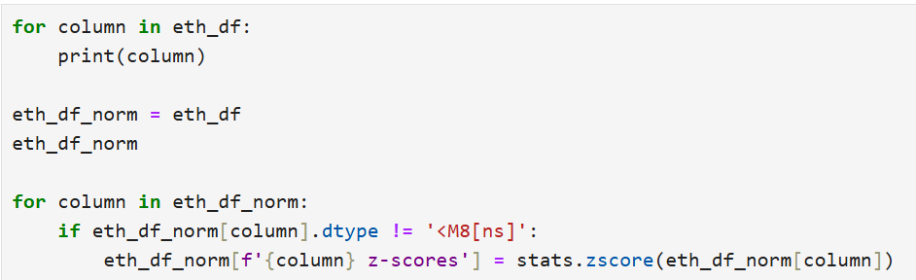
Normalization
Topic
Preprocessing

Slide 10
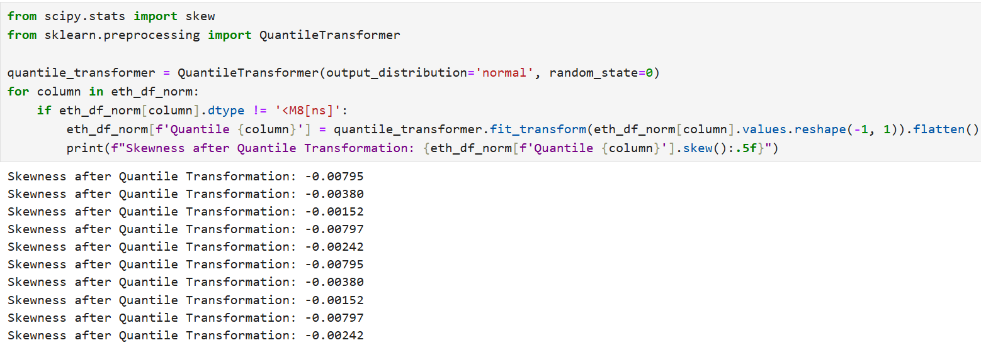
Skewness
Topic
Preprocessing

Slide 11
Techniques Selected
Topic
Techniques and Modeling
Random Forest Regressor
Combines decision trees
Handles complex relationships
Linear Regressions
Establishes baseline for predictions
Assumes straight-line relationship

Slide 12
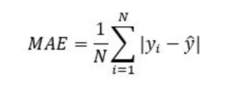
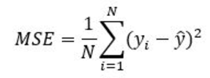
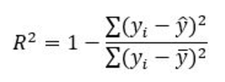
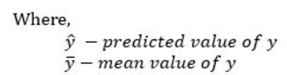
Evaluation
Techniques and Modeling
Mean Absolute Error
Average differences in predicted and actual
Root Mean Squared Error
Larger prediction errors to understand accuracy
R squared
Shows how well model captures price changes

Slide 13
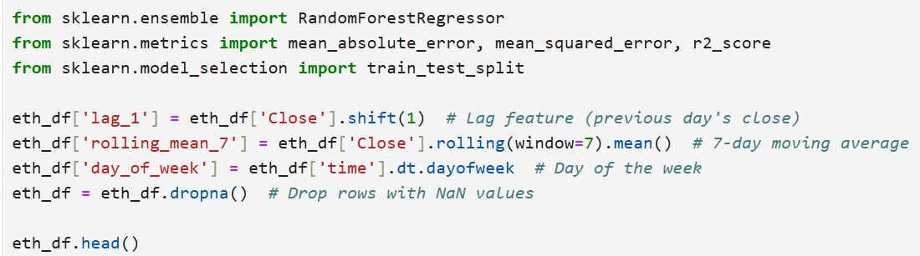
Random Forest Regressor
Topic
Techniques and Modeling

Slide 14
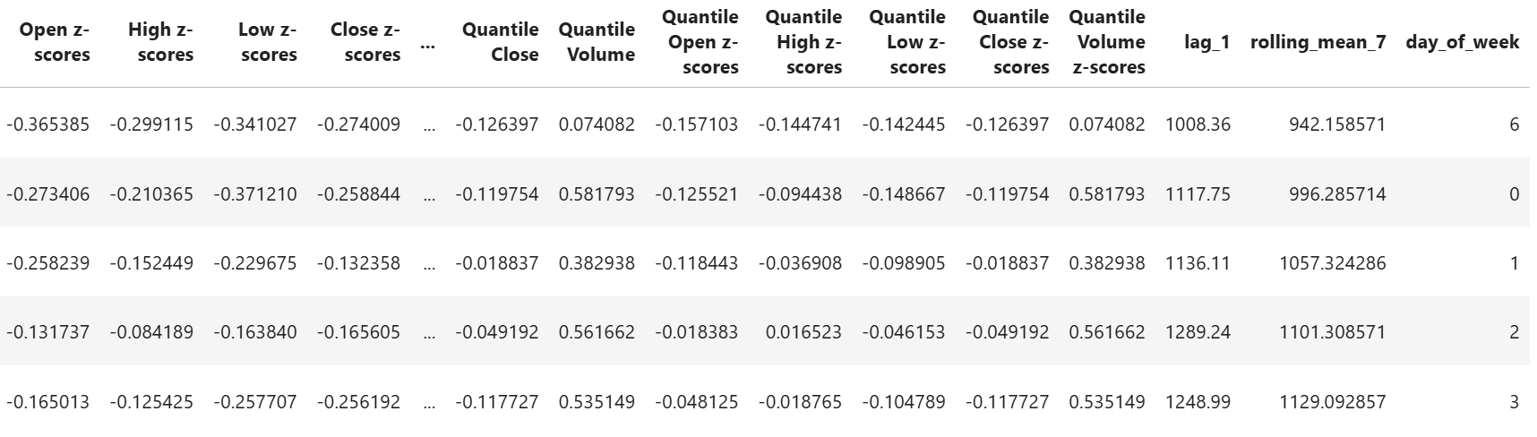
Random Forest Regressor
Topic
Techniques and Modeling

Slide 15
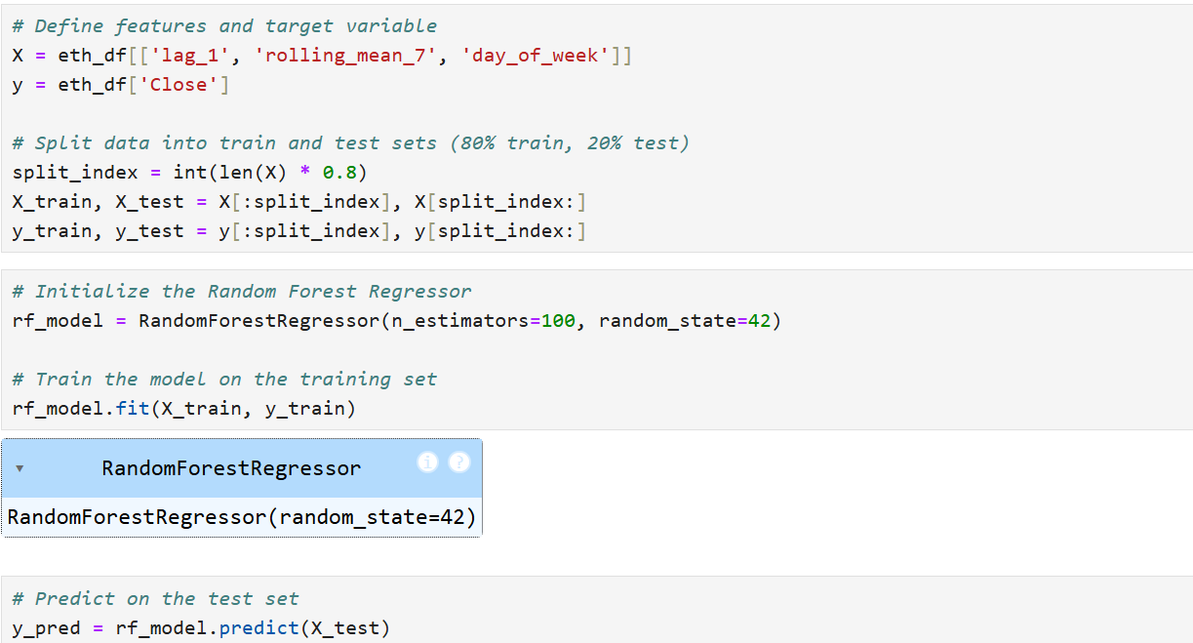
Random Forest Regressor
Topic
Techniques and Modeling

Slide 16
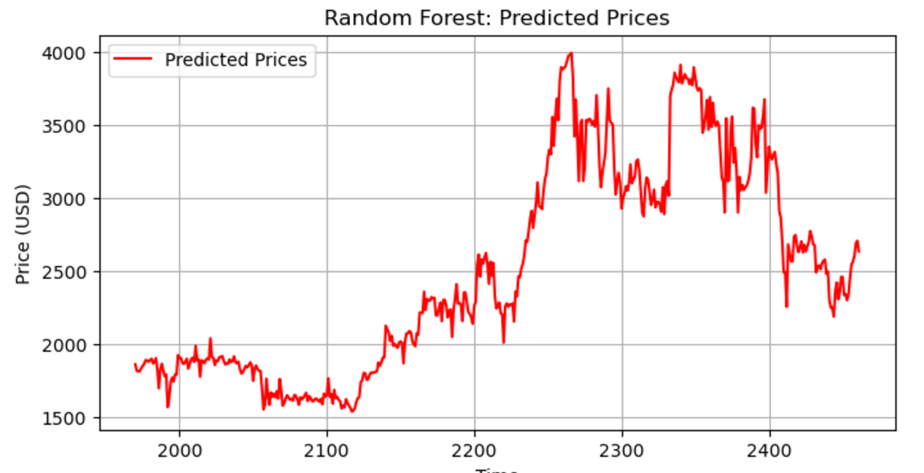
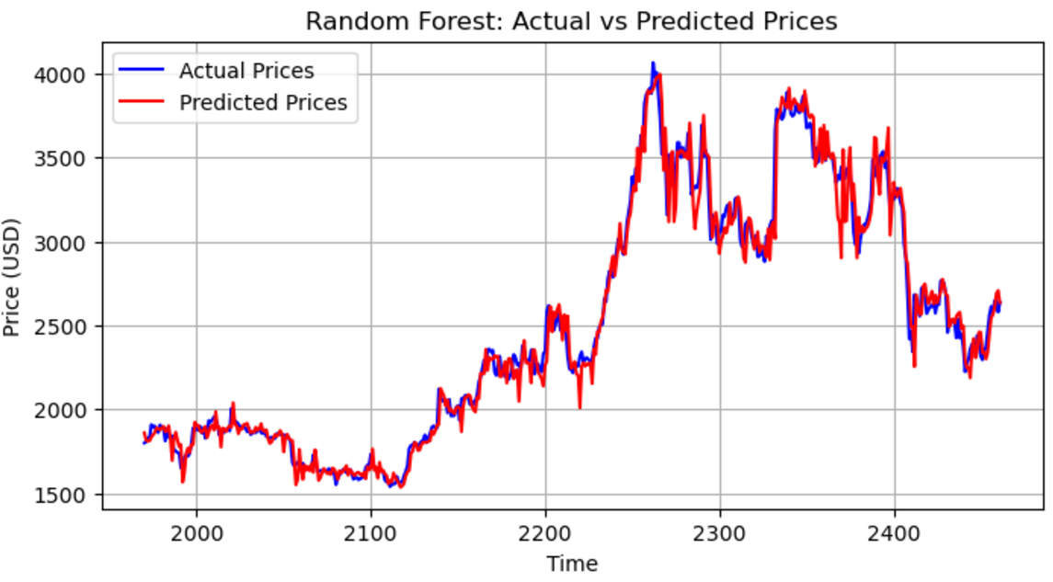

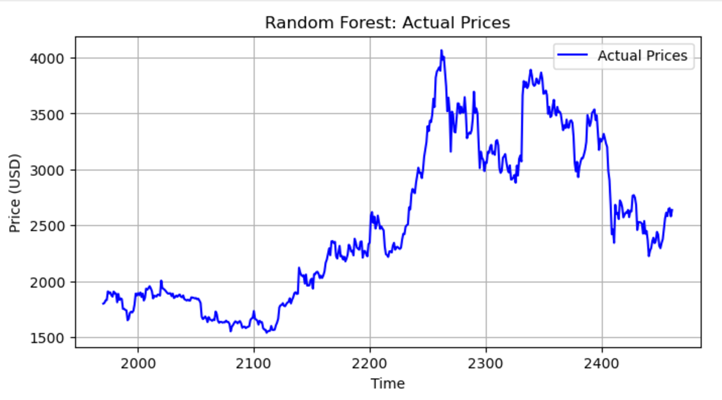
Random Forest Regressor
Results
Mean Absolute Error (MAE): 71.59
Root Mean Squared Error (RMSE): 105.86
R² Score: 0.978

Slide 17
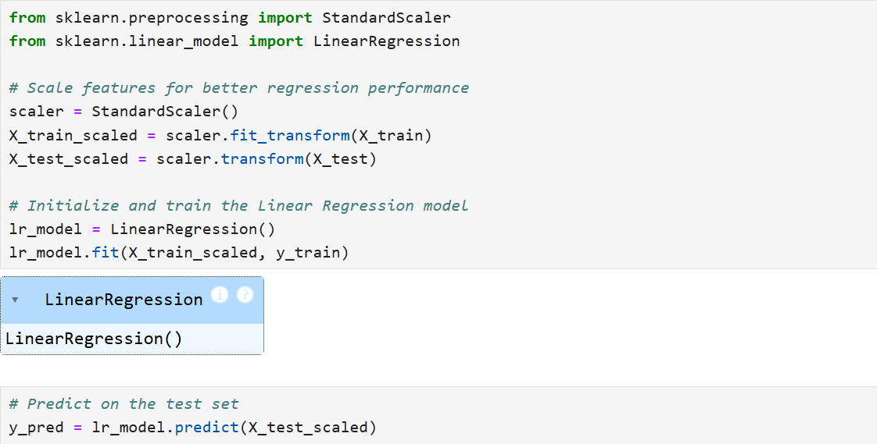
Linear Regression
Topic
Techniques and Modeling

Slide 18
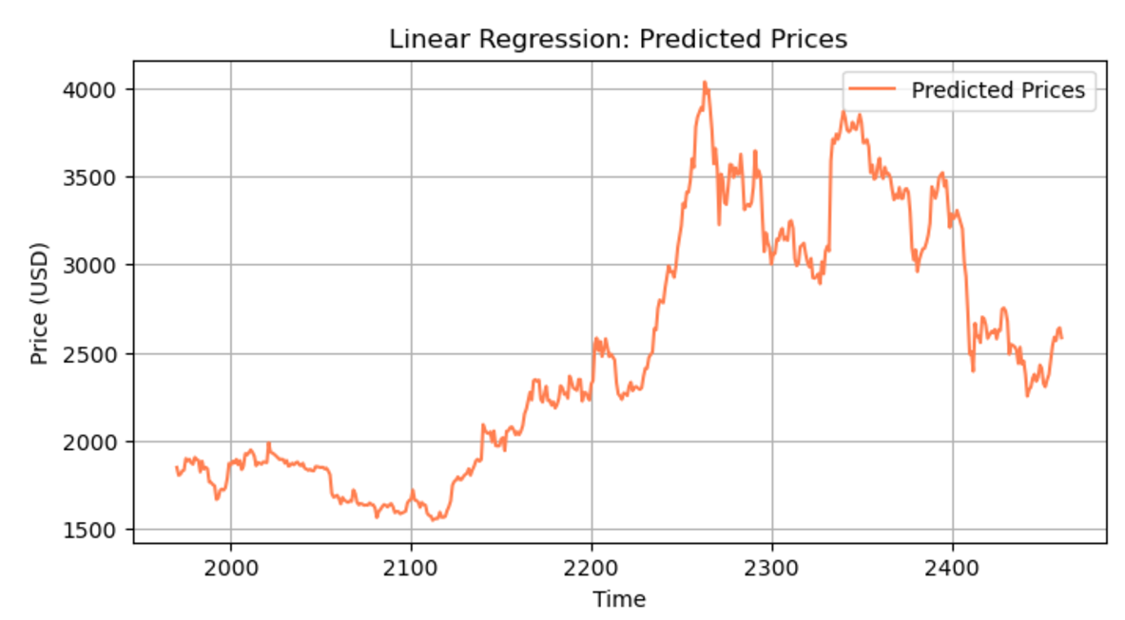
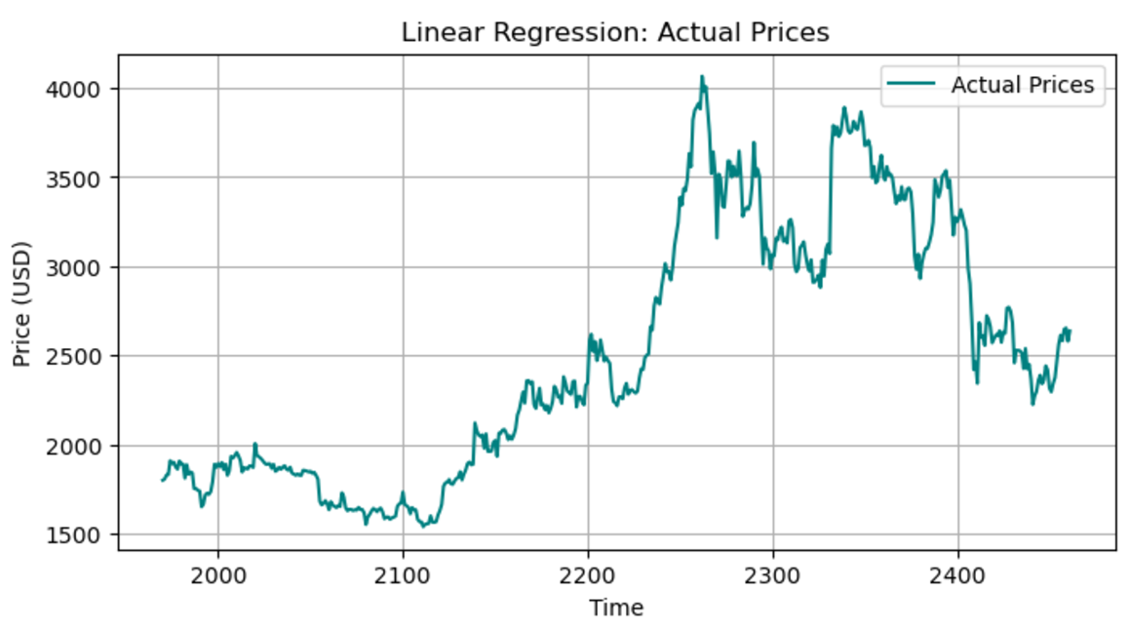
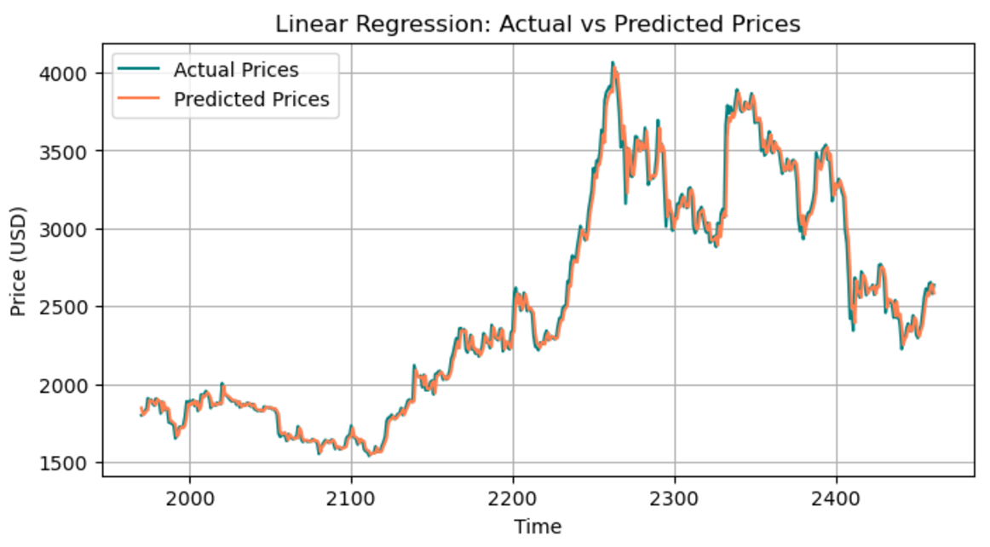
Linear Regression
Results
Mean Absolute Error (MAE): 51.48
Root Mean Squared Error (RMSE): 80.59
R² Score: 0.99

Slide 19
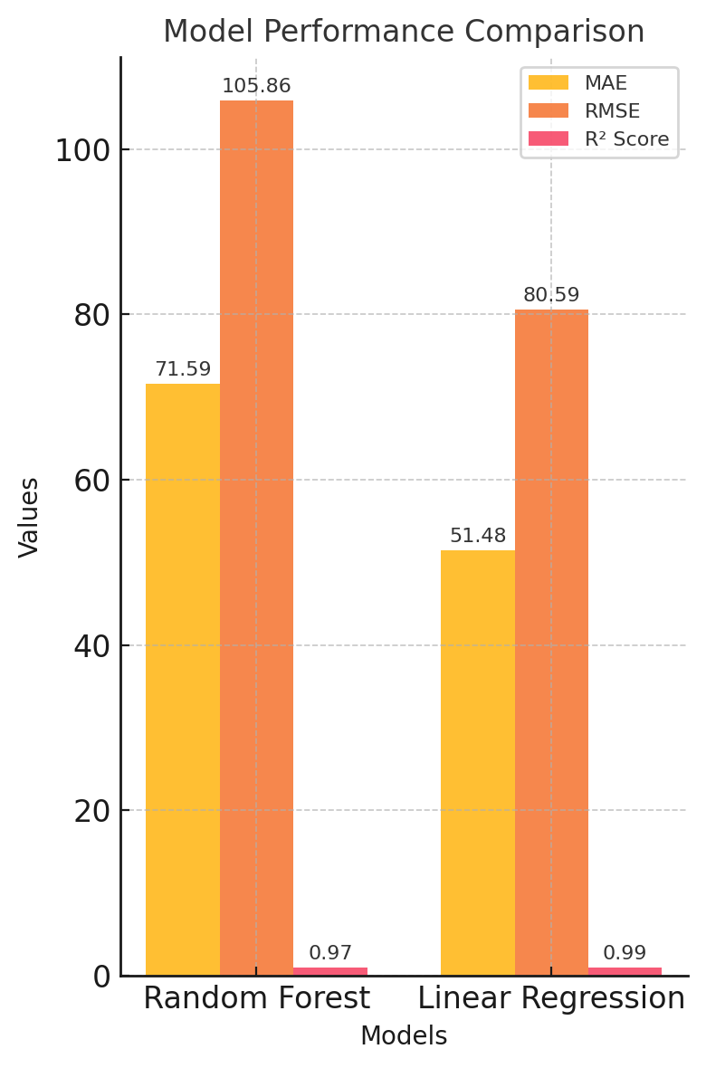
Comparison
Evaluation
Random Forest Regressor:
Mean Absolute Error (MAE): 71.59
Root Mean Squared Error (RMSE): 105.86
R² Score: 0.978
Linear Regression:
Mean Absolute Error (MAE): 51.48
Root Mean Squared Error (RMSE): 80.59
R² Score: 0.99

Slide 20
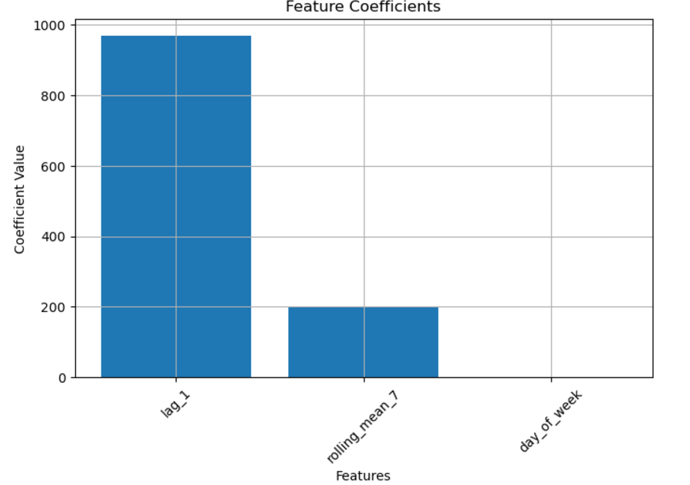
Coefficient Values
Evaluation
Feature Coefficient:
Lag_1: 968.15
rolling_mean_7: 197.34
day_of_week: 0.32

Slide 21
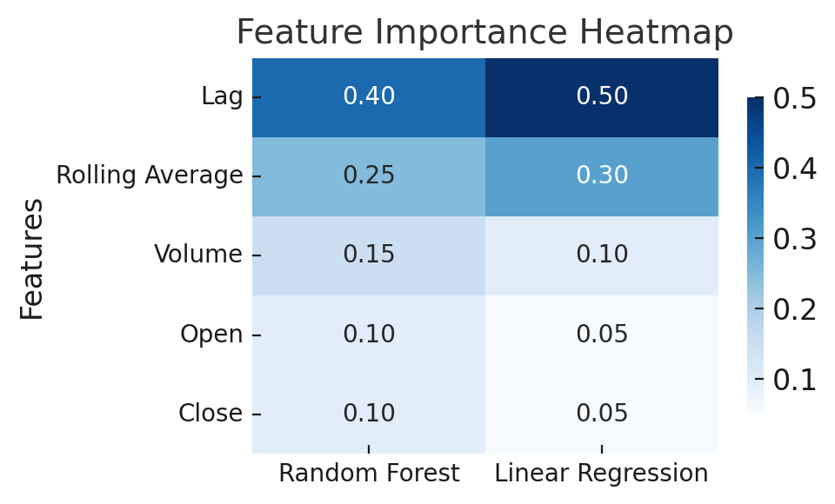
Interpretation
Evaluation
Linear Regression provided more accurate prediction in comparison to Random Forest and showed feature importance
Random forest can capture complex patterns, but did not outperform linear regression
Both models followed trends and predicted close to actual, but linear regression did it best
Coefficients show that the lag and rolling averages were key to predicting prices

Slide 22

Real World Implications
Insights
Help traders make better decisions
Manage risks
Understand what drives the market
Using methods for other cryptocurrencies

Slide 23

SUMMARY
1
We performed Random Forest and Linear Regression techniques on time series ethereum data to predict market trends
2
We found that linear regression was better suited for such analysis, and learned what created features were ket in prediction
3
This research could help investors manage risks and make better decisions

Slide 24

THANK YOU
Any Questions?

